Slide 1
Financial Management
Lecture 10: Cost of Capital and Capital Structure

Slide 2
THE COST OF CAPITAL: AN OVERVIEW

Slide 3
Learning objectives
Understand the concepts underlying the firm’s overall cost of capital and the purpose for its calculation.
Evaluate a firm’s capital structure, and determine the relative importance (weight) of each source of financing.
Calculate the after-tax cost of debt, preference shares and ordinary shares.
Calculate a firm’s weighted average cost of capital.

Slide 4
The cost of capital: An overview
Cost of Equity
Cost of Debt

Slide 5
The cost of capital: An overview
A firm’s weighted average cost of capital, or WACC, is the weighted average of the required returns of the securities that are used to finance the firm.
WACC incorporates the required rates of return of the firm’s lenders and investors and also accounts for the particular mix of financing.

Slide 6
The cost of capital: An overview (cont.)
The riskiness of a firm affects its WACC in two ways:
  The required rate of return on debt and equity securities the firm issues will be higher if the firm is riskier, and
  Risk will influence how the firm chooses to finance, i.e. the proportion of debt and equity.

Slide 7
The cost of capital: An overview (cont.)
WACC is useful in a number of settings:
  WACC is used to value the entire firm
  WACC is often used as a starting point for determining the discount rate for investment projects
  WACC is the appropriate rate to use when evaluating firm performance.

Slide 8
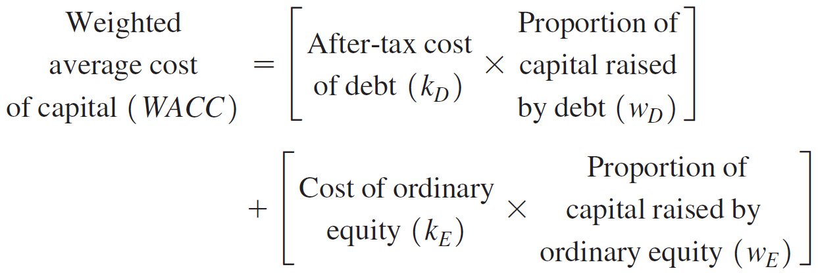
WACC equation

Slide 9
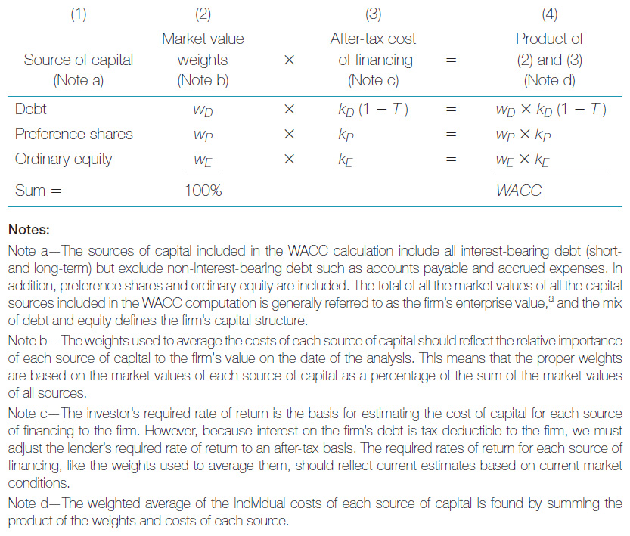
A template for calculating WACC

Slide 10
Three-step procedure for estimating the firm’s WACC
Define the firm’s capital structure by determining the weight of each source of capital. (See column 2, Figure)
Estimate the opportunity cost of each source of financing. These costs are equal to the investor’s required rates of return after adjusting the cost of debt for the effect of tax. (See column 3, Figure)

Slide 11
Three-step procedure for estimating the firm’s WACC (cont.)
Calculate a weighted average of the costs of each source of financing. This step requires calculating the product of the after-tax cost of each capital source used by the firm and the weight associated with each source. The sum of these products is the WACC. (See column 4, Figure)

Slide 12
DETERMINING THE FIRM’S CAPITAL-STRUCTURE WEIGHTS

Slide 13
Determining the firm’s capital structure weights
The weights are based on the following sources of financing: interest-bearing debt (both short- and long-term), preference shares and ordinary shares. Liabilities such as accounts payable are not included in capital structure.

Slide 14
Determining the firm’s capital structure weights (cont.)
In theory, market value is preferred for all securities. However, not all market values may be readily available.
In practice, we generally use book values for debt and market values for equity securities.

Slide 15
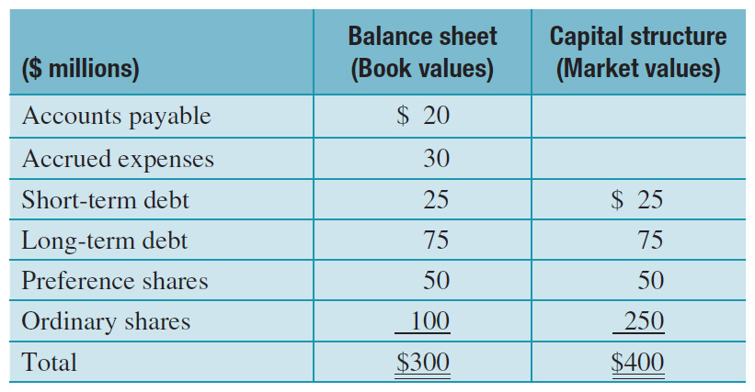
Determining the firm’s capital structure weights (cont.)

Slide 16
CHECKPOINT: CHECK YOURSELF
Calculating the WACC

Slide 17
The problem
Templeton was considering the acquisition of a chain of extended-care facilities and wanted to estimate its own WACC as a guide to the cost of capital for the acquisition. Templeton’s capital structure consists of the following (in millions of dollars): debt, $100; preference shares, $50; ordinary shares, $250, for a total of $400. Templeton contacted the firm’s investment banker to get estimates of the firm’s current cost of financing and was told that if the firm were to borrow the same amount of money today, it would have to pay lenders 10%.

Slide 18
The problem (cont.)
Given the firm’s 30% tax rate, however, the after-tax cost of borrowing would only be 7%. Preference shareholders currently demand a 12% rate of return and ordinary shareholders demand 15%. Templeton’s CFO knew the WACC would be somewhere between 7% and 15% because the firm’s capital structure is a blend of the three sources of capital whose costs are bounded by this range.

Slide 19
Step 1: Picture the problem
The weighted average cost of capital combines the after-tax cost of financing for each of the firm’s sources of capital in a weighted average, where the weights are proportionate to the relative importance of each source of financing in the firm’s capital structure (note that these are market—not book—values) as follows:

Slide 20
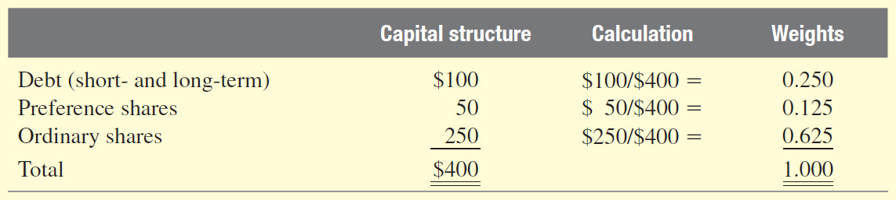
Step 1: Picture the problem (cont.)

Slide 21
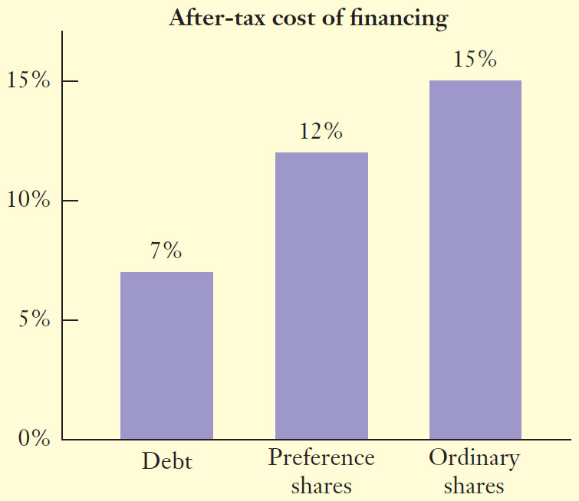
Step 1: Picture the problem (cont.)

Slide 22
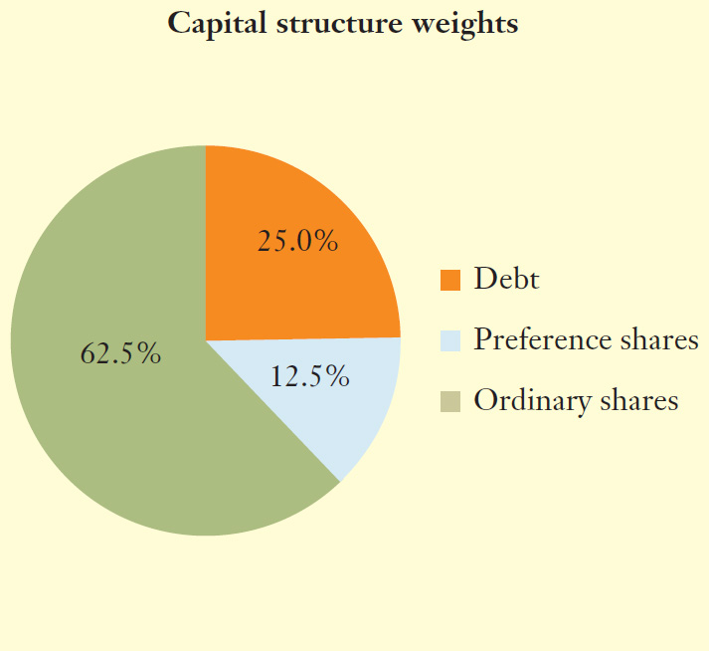
Step 1: Picture the problem (cont.)

Slide 23
Step 2: Decide on a solution strategy
To calculate the weighted average, we sum the products of the after-tax cost of each source of financing multiplied by its corresponding capital-structure weight, as defined in following equation:

Slide 24
Step 2: Decide on a solution strategy (cont.)

Slide 25
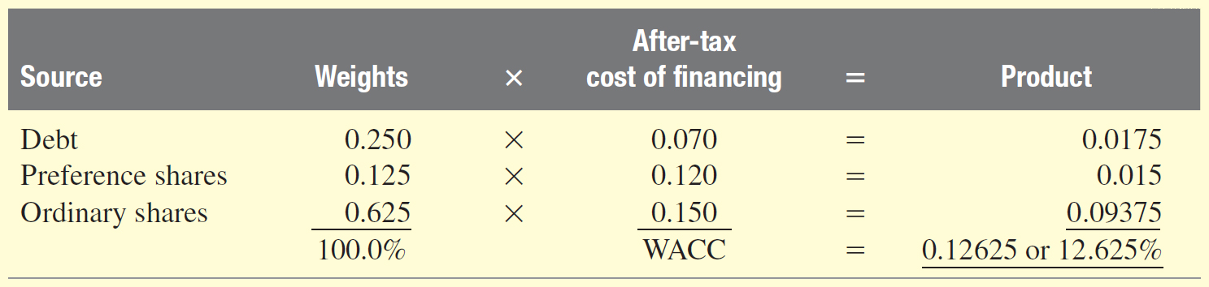
Step 3: Solve
Using the template found in earlier Figure, we calculate Templeton’s WACC as follows:

Slide 26
Step 4: Analyse
Templeton’s CFO estimated that the firm’s WACC is 12.625%, which lies within the range between the highest cost source of capital (ordinary shares at 15%) and the lowest (debt at 7%). The weighted average is much closer to the cost of ordinary equity than to the cost of debt, because 62.5% of the firm’s financing has been raised from ordinary shares.

Slide 27
Estimating the Cost of Individual Sources of Capital

Slide 28
The cost of debt
The cost of debt is the rate of return the firm’s lenders demand when they loan money to the firm. We estimate the market’s required rate of return on a firm’s debt using its yield to maturity and not the coupon rate.

Slide 29
The cost of debt (cont.)
Example: What will be the yield to maturity on a debt that has par value of $1000, a coupon interest rate of 7% that pays annually, time to maturity of 20 years and is currently trading at $945? What will be the cost of debt if the tax rate is 30%?

Slide 30
The cost of debt (cont.)
Enter:
  N = 20; PV = -945; PMT = 70; FV =1000
  I/Y = 7.54%
  After-tax cost of debt = Yield (1-tax rate)
  = 7.54 (1-.3)
  = 5.28%

Slide 31
The cost of debt (cont.)
It is not easy to find the market price of a specific bond. It is a standard practice to estimate the cost of debt using yield to maturity on a portfolio of bonds with similar credit rating and maturity as the firm’s outstanding debt.

Slide 32
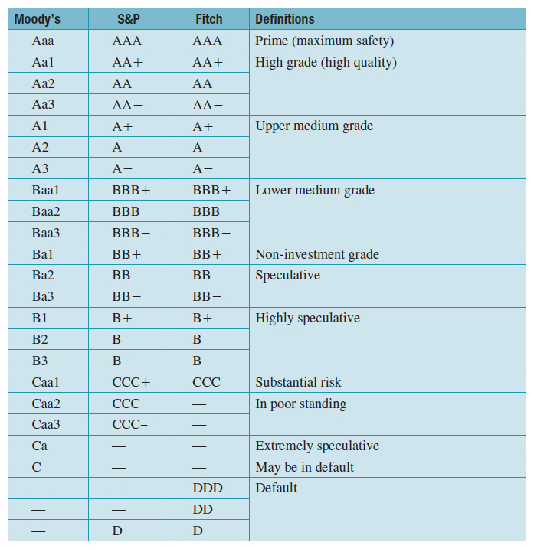
A guide to corporate bond ratings

Slide 33
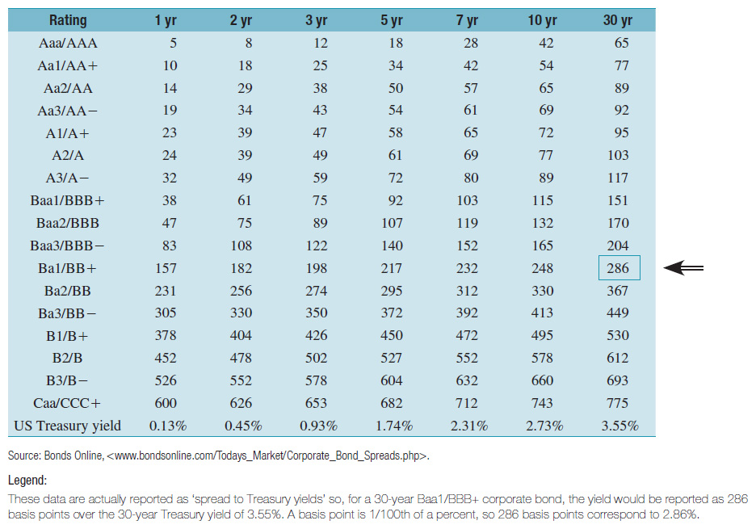
Corporate bond yields: Default ratings and term to maturity
Reproduced with permission of BondsOnline.com.

Slide 34
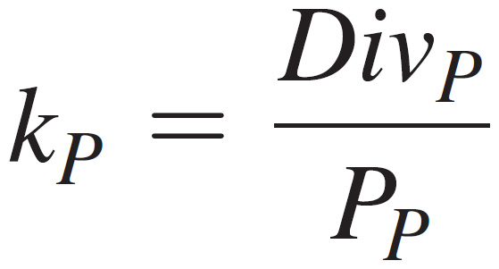
The cost of preference shares
The cost of preference shares is the rate of return investors require of the firm when they purchase its preference shares.

Slide 35
The cost of preference shares (cont.)
Example: Consider the preference shares of Adelaide Power Company, which are trading at $23.35 per share. What will be the required rate of return on these shares if they have a par value of $25 and pay an annual dividend of 5.3%?
Using equation (14-2a)
k_{ps} = $1.325 ÷ $23.35 = .0567 or 5.67%

Slide 36
The cost of ordinary shares
The cost of ordinary equity capital is the cost of ordinary share financing to the firm, and is the rate of return investors expect to receive from investing in a firm’s shares. This return comes in the form of dividends and proceeds from the sale of the stock.

Slide 37
The cost of ordinary shares (cont.)
There are two approaches to estimating the cost of ordinary equity:
  The dividend growth model
  CAPM

Slide 38
The dividend growth model: Discounted cash flow approach
Estimate the expected stream of dividends that the common stock is expected to provide.
Using these estimated dividends and the firm’s current stock price, calculate the internal rate of return on the stock investment.

Slide 39
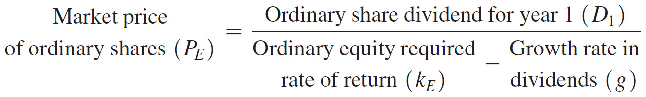
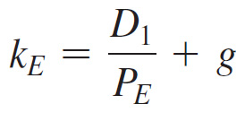
The dividend growth model: Discounted cash flow approach (cont.)

Slide 40
CHECKPOINT : CHECK YOURSELF
Estimating the cost of ordinary shares for Pearson plc using the dividend growth model

Slide 41
The problem
Pearson plc is an international media company that operates three business groups: Pearson Education, the Financial Times and Penguin. In late 2014, Pearson’s CFO called for an update of the firm’s cost of capital. The first phase of the estimation focused on the firm’s cost of ordinary shares. How would the CFO determine the cost of the company’s shares, using the dividend growth model?

Slide 42
Step 1: Picture the problem
The financial analyst decided to first look at the dividend growth model to get an initial estimate of the cost of ordinary shares. The equation for the cost of ordinary shares using the dividend growth model describes the cost of ordinary shares as the sum of two components: the expected dividend yield for the coming year (D1/PE) plus the expected rate of growth in dividends, g.

Slide 43
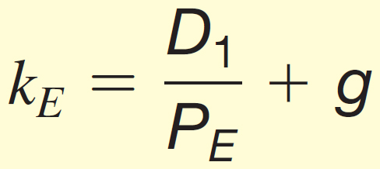
Step 1: Picture the problem (cont.)

Slide 44
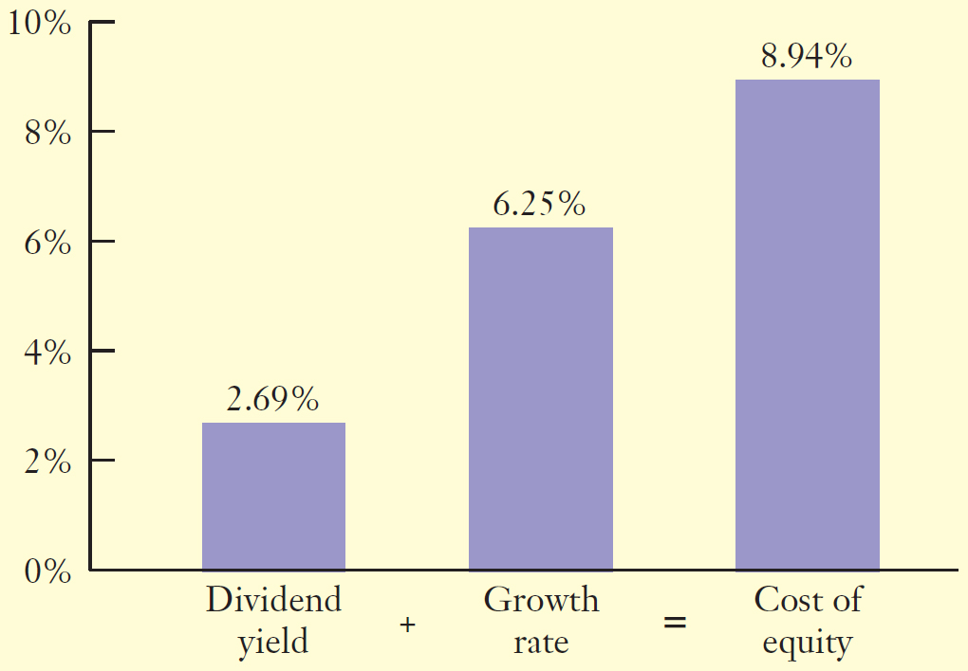
Step 1: Picture the problem (cont.)
We need three numbers to carry out the estimate of the cost of ordinary shares:

Slide 45
Step 2: Decide on a solution strategy
To estimate the dividend for 2015, we multiply Pearson’s $0.822 in dividends for 2014 by 1 plus the estimated rate of growth in dividends of 7.90%. It is standard practice to rely on outside equity analysts whose estimates of growth in earnings (and, consequently, dividends) are published regularly in analyst reports found on the Internet. All that is required now is to substitute these values into equation).

Slide 46
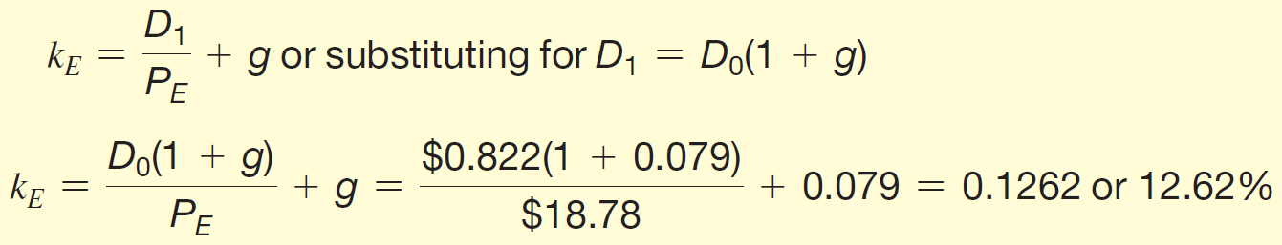
Step 3: Solve
Substituting into equation, we calculate our estimate of the cost of ordinary equity for Pearson as:

Slide 47
Step 4: Analyse
Pearson’s cost of ordinary shares is estimated to be 12.62%. The key driver of this estimate is the growth rate in Pearson’s dividends, which Pearson’s analyst established at 7.90%. This is a very difficult estimate to make, and the number we choose has a dramatic impact on the estimated cost of ordinary shares.

Slide 48
Estimating the rate of growth, g
The growth rate can be obtained from:
  Websites that post analysts’ forecasts for the coming year and the next five years, and
  Using historical data to compute the arithmetic or geometric average.

Slide 49
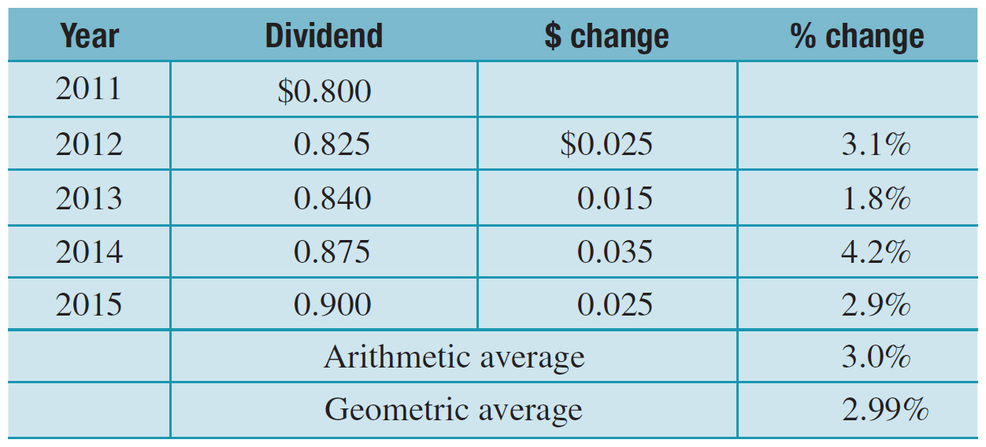
Estimating the rate of growth, g (cont.)

Slide 50
Pros and cons of the dividend growth model approach
Pros: Easy to use; straightforward method of estimating an investor’s required rate of return.
Cons: Forecasting the growth rate of a firm’s dividends requires the use of complex valuation models in which dividends are expected to grow at varying rates; requires estimating the period of initial growth as well as two different growth rates.

Slide 51
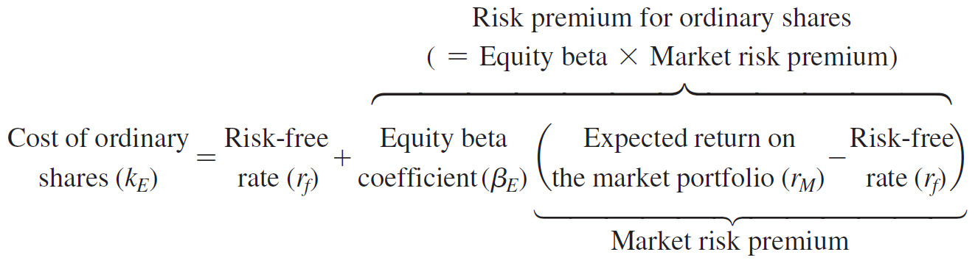
The capital asset pricing model
CAPM was designed to determine the expected or required rate of return for risky investments.

Slide 52
The capital asset pricing model (cont.)
Equation illustrates that the expected return on common stock is determined by three key ingredients:
  The risk-free rate of interest,
  The beta or systematic risk of the ordinary share’s returns, and
  The market risk premium.

Slide 53
Advantages and disadvantages of the CAPM approach
Pros – Easy to use; does not depend on dividends or assumptions about the growth-rate in dividends.
Cons – The choice of a risk-free rate is not clearly defined; estimates of beta and market risk premium will vary depending on the data used.

Slide 54
CHECKPOINT : CHECK YOURSELF
A review of current market conditions on 12 August 2014 reveals that the 10-year Australian Treasury bond yield that we will use to measure the risk-free rate was 3.42%, the estimated market risk premium is 6%, and the beta for Pearson’s ordinary shares is 0.97. Determine Pearson’s cost of ordinary equity using the CAPM, as of 12 August 2014.

Slide 55

Step 1: Picture the problem
The CAPM describes the relationship between the expected rates of return on risky assets in terms of their systematic risk; that is:

Slide 56
Step 1: Picture the problem (cont.)
The risk premium for an ordinary share is estimated as the beta of the risky ordinary share, b_{E}, multiplied by the market risk premium for the portfolio of all risky assets (r_{M} - r_{f}). If the market risk premium for all risky assets is 6%, and the ordinary share’s beta is 0.979, then the risk premium for the ordinary shares is equal to 0.97 times 6%, or 5.82%. In graphic terms:

Slide 57
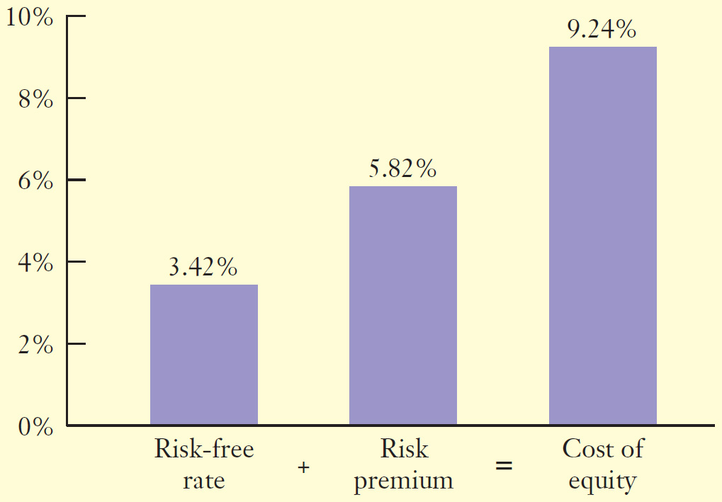
Step 1: Picture the problem (cont.)

Slide 58
Step 2: Decide on a solution strategy
Estimating the cost of ordinary equity for Pearson requires that we arrive at estimates of two market factors and one firm-specific factor. The market factors in equation (14–4) consist of the risk-free rate of interest (3.42% at the time of the analysis) and the market risk premium (estimated to be 6%). The firm-specific factor is Pearson’s beta coefficient (estimated to be 0.97).

Slide 59
Step 3: Solve
Substituting for the risk-free rate, beta for Pearson, and the risk premium for the market into equation, we calculate an estimate of the cost of ordinary equity for Pearson; that is:

Slide 60
Step 4: Analyse
Pearson’s cost of ordinary equity is estimated to be 9.24%, based on our estimates of the risk-free rate of interest of 3.42%, the company’s equity beta of 0.97, and an estimated market risk premium of 6%.
This estimate, however, is subject to considerable error because each of the three key factors (risk-free rate, beta and market risk premium) is a rough estimate.

Slide 61
SUMMING UP:
CALCULATING THE FIRM’S WACC

Slide 62
Summing Up: Calculating the firm’s WACC
When estimating the firm’s WACC, the following issues should be kept in mind:
  Weights should be based on market rather than book values of the firm’s securities.
  Use market-based opportunity costs that reflect current required rates of return rather than historical rates.
  Use forward-looking weights and opportunity costs.

Slide 63
CAPITAL STRUCTURE

Slide 64
Learning objectives
Describe a firm's capital structure.
Explain why firms have different capital structures and how capital structure influences a firm's weighted average cost of capital (WACC).
Describe some fundamental differences in industries that drive differences in the way they finance their investments.
Use the basic tools of financial analysis to analyse a firm's financing decisions.

Slide 65
A glance at capital-structure choices in practice
The primary objective of capital structure management is to maximise the total value of the firm's outstanding debt and equity.
The resulting financing mix that maximises this combined value is called the optimal capital structure.

Slide 66
Financial leverage
By borrowing a portion of the firm's capital at a fixed rate of interest, the firm can ‘leverage’ the rate of return it earns on its total capital into an even higher rate of return on the firm's equity.
For example, if the firm is earning 15% on its investments and paying only 9% on borrowed money, the 6% differential goes to the firm's owners. This is known as favourable financial leverage. If it earns less than 9%, it will experience unfavourable financial leverage.

Slide 67
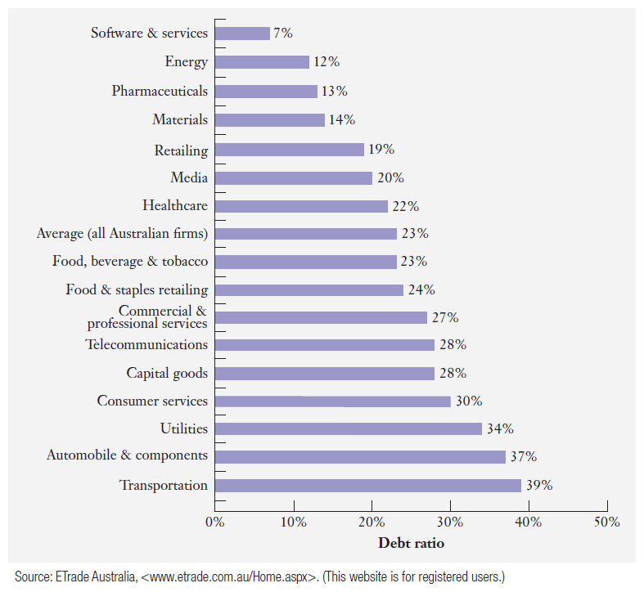
How do firms in different industries finance their assets?
Debt ratios for selected Australian industries

Slide 68
A first look at the Modigliani and Miller Capital Structure Theorem
Modigliani and Miller showed that, under some idealistic conditions, the level of debt in a firm’s capital structure has no influence on its value. The theorem relies on two basic assumptions:
  The cash flows that a firm generates are not affected by how the firm is financed.
  Financial markets are perfect.

Slide 69
A first look at the Modigliani and Miller Capital Structure Theorem (cont.)
Assumption 1, as illustrated in following Figure, implies that the total amount of cash that the firm distributes to both its debt holders and equity holders is always equal to the firm’s cash flow regardless of how the firm constructs its capital structure.

Slide 70
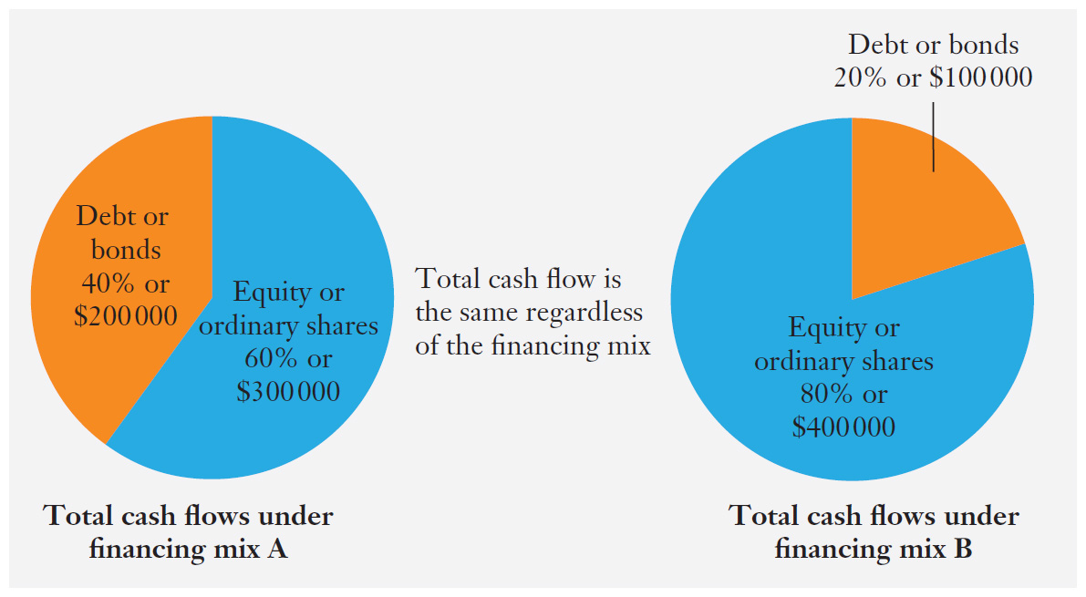
Assumption 1: Cash distributions to bondholders and shareholders are not affected by financial leverage

Slide 71
A first look at the Modigliani and Miller Capital Structure Theorem (cont.)
Assumption 2, the perfect financial markets assumption, implies that the packaging of cash flows (i.e. whether distributed to investors as dividends or interest payments) is not important.
If these two assumptions hold, the total market value of the firm’s debt and equity is independent of its capital-structure decision, and the particular mix of debt and equity financing does not matter.

Slide 72
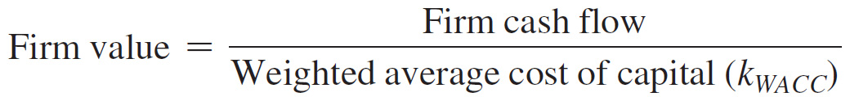
Capital structure, the cost of equity and the weighted average cost of capital
When there is no tax, the firm's weighted average cost of capital is also unaffected by its capital structure.
Assume we are valuing a firm whose cash flows are a level perpetuity. The value of the firm then is simply the ratio of the firm’s free cash flow divided by its weighted average cost of capital:

Slide 73
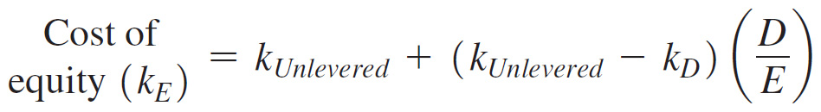
Capital structure, the cost of equity and the weighted average cost of capital (cont.)
Since firm value and firm cash flows are unaffected by the choice of capital structure, the firm's weighted average cost of capital is also unaffected. Thus, the relationship between the cost of equity and the debt-to-equity ratio is as follows:

Slide 74
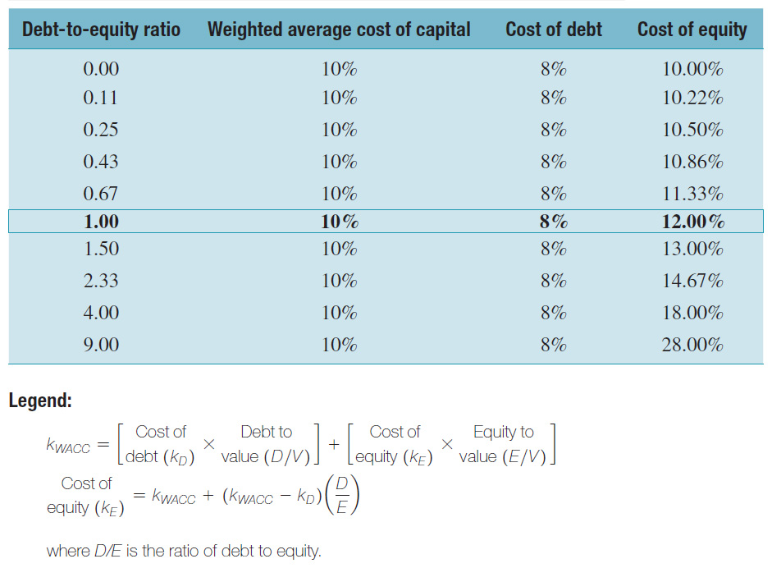
Cost of capital and capital structure: M&M theorem (cont.)

Slide 75
Capital structure, the cost of equity, and the weighted average cost of capital (cont.)
As seen in the example, the cost of equity equation increases with the debt-to-equity ratio (D/E).
However, because of less weight on the more expensive equity, the firm’s WACC equation does not change and is always equal to the cost of capital of an unlevered firm.

Slide 76
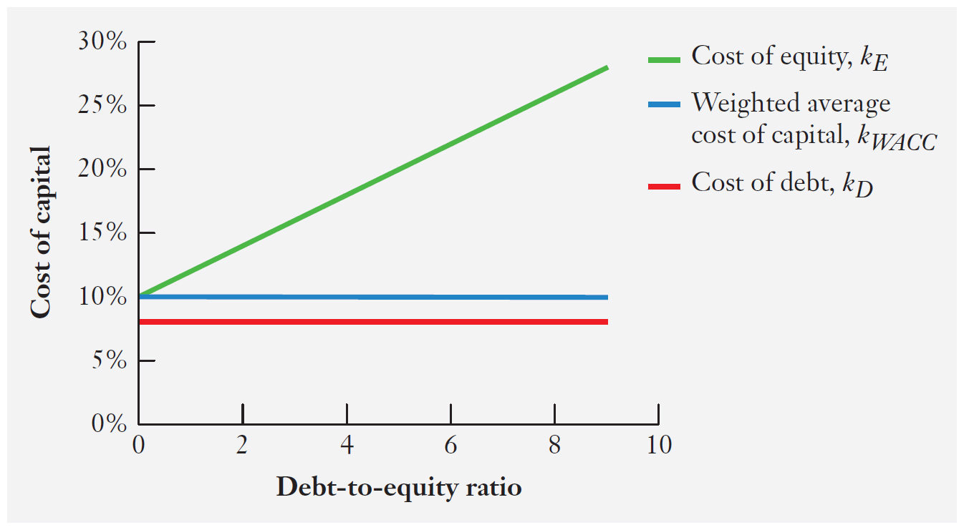
Cost of capital and capital structure: M&M theorem

Slide 77
Why capital structure matters in reality
Financial managers care a great deal about how their firms are financed. Indeed, there can be negative consequences for firms that select an inappropriate capital structure, which means that, in reality, at least one of the two M&M assumptions is violated.

Slide 78
Violations of Assumption 2
Transaction costs can be important and, because of these costs, the rate at which investors can borrow may differ from the rate at which firms can borrow.
When this is the case, firm values may depend on how the firms are financed because individuals cannot substitute their individual borrowing for corporate borrowing in order to achieve a desired level of financial leverage.

Slide 79
Violations of Assumption 1
There are three reasons why capital structure affects the total cash flows available to a firm's debt and equity holders:
  Interest is a tax-deductible expense, while dividends paid to shareholders are not. Thus, after taxes, firms have more money to distribute to their debt and equity holders if they use debt financing. However, Australia’s dividend imputation system tends to reduce this preference for debt financing.

Slide 80
Violations of Assumption 1 (cont.)
  Debt financing creates a fixed legal obligation. If the firm defaults on its payments, the firm will incur the added cost that the bankruptcy process entails.
  The threat of bankruptcy can influence the behavior of a firm's executives as well as its employees and customers.

Slide 81
Corporate tax and capital structure: Classical tax system (cont.)
Consider two firms identical in every respect except for their capital structure.
  Firm A has no debt and has total equity financing of $2000.
  Firm B has borrowed $1000 on which it pays 5% interest and raised the remaining $1000 with equity.
  Each firm has operating income of $200.
  The corporate tax rate is 30%.

Slide 82
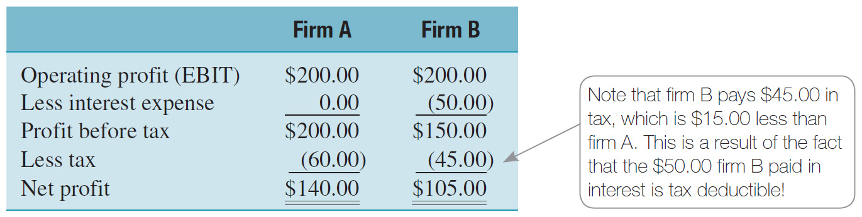
Corporate tax and capital structure: Classical tax system (cont.)

Slide 83
Corporate tax and capital structure: Classical tax system(cont.)
If we assume that both firms pay out 100% of earnings in ordinary share dividends, we get the following:
 | Firm A | Firm B
Equity dividends | $140 | $105.00
Interest payments | - | $50.00
Total distributions (to stockholders and bondholders) | $140.00 | $155.00

Slide 84
Corporate taxes and capital structure (cont.)
The $15.00 difference can be traced to the tax benefits of interest payments,
0.30 × $50 = $15.00.
This is referred to as interest tax shield.
These tax savings add value to the firm and in particular to its shareholders.

Slide 85
Corporate tax and the WACC
The tax deductibility of interest expense causes the firm's weighted average cost of capital to decline as it includes more debt in the capital structure.

Slide 86
Corporate taxes and the WACC (cont.)
Consider the example, where the cost of unlevered equity financing is assumed to be 10% and the cost of debt is 8% before tax. If we assume a 30% tax rate, what will be the cost of equity and weighted average cost of capital if the debt-to-equity ratio is 1 (i.e. 50% debt and 50% equity)?
Cost of equity (kE) = 0.10 + [(0.10 − 0.08)(1.0) x (1 - 0.3)] = 0.114 or 11.4%

Slide 87
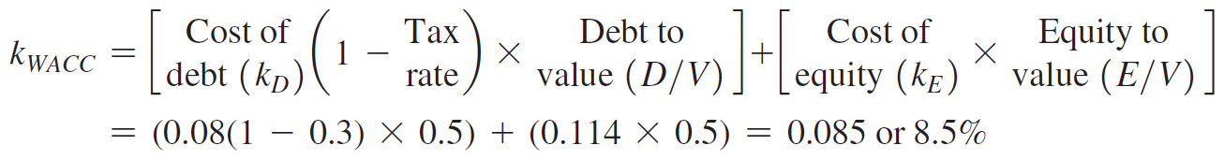
Corporate tax and the WACC (cont.)
k_{WACC} = (0.08(1-0.3) × 0.5) + (0.114 × 0.5)
k_{WACC} = 0.085 or 8.5%

Slide 88
Corporate tax and the WACC (cont.)
Clearly, the implication of the tax deductibility of interest expense and a classical tax system, for capital-structure policy, favours the use of debt over equity.
The logical extension of this is that the more debt there is in the capital structure, the greater the wealth of shareholders, and one could argue that a firm should aim for 99.9% debt.

Slide 89
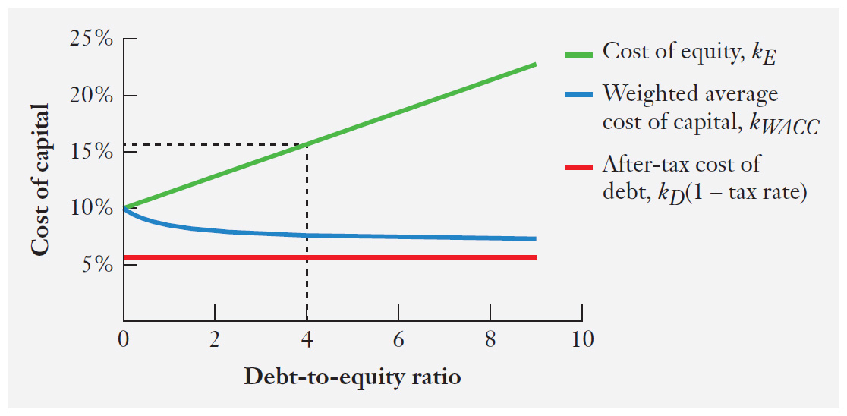
The cost of equity and WACC with tax-deductible interest expense (classical tax system)

Slide 90
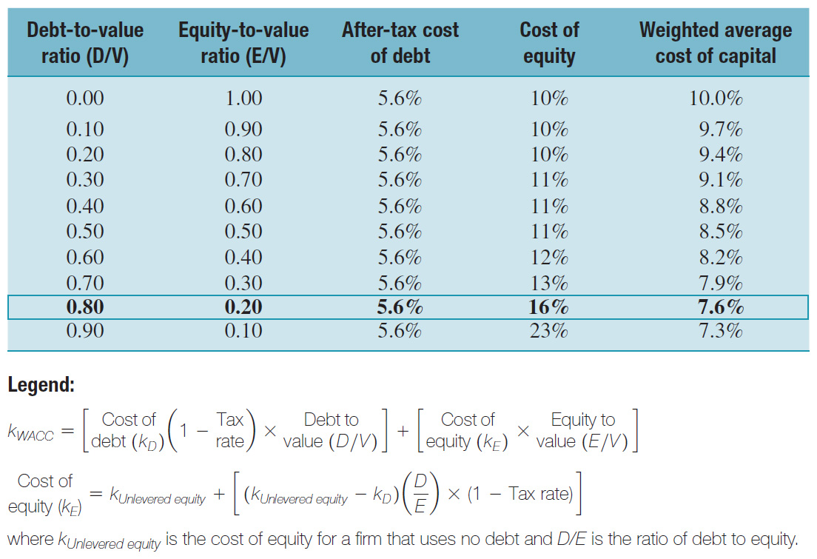
The cost of equity and WACC with tax-deductible interest expense (classical tax system) (cont.)

Slide 91
Bankruptcy and financial-distress costs
Even though debt provides valuable tax savings, a firm cannot keep on increasing debt. If the firm's debt obligations (i.e. interest expense) exceed its ability to generate cash, it will need to work out a deal with its bankers or bondholders to restructure its debt, or it may be forced into bankruptcy. In either case, a failure to meet its debt obligations can generate substantial costs to the firm, referred to as financial distress costs.

Slide 92
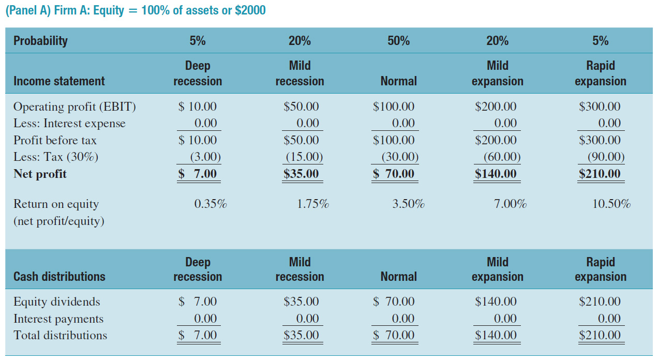
Leverage and the probability of default

Slide 93
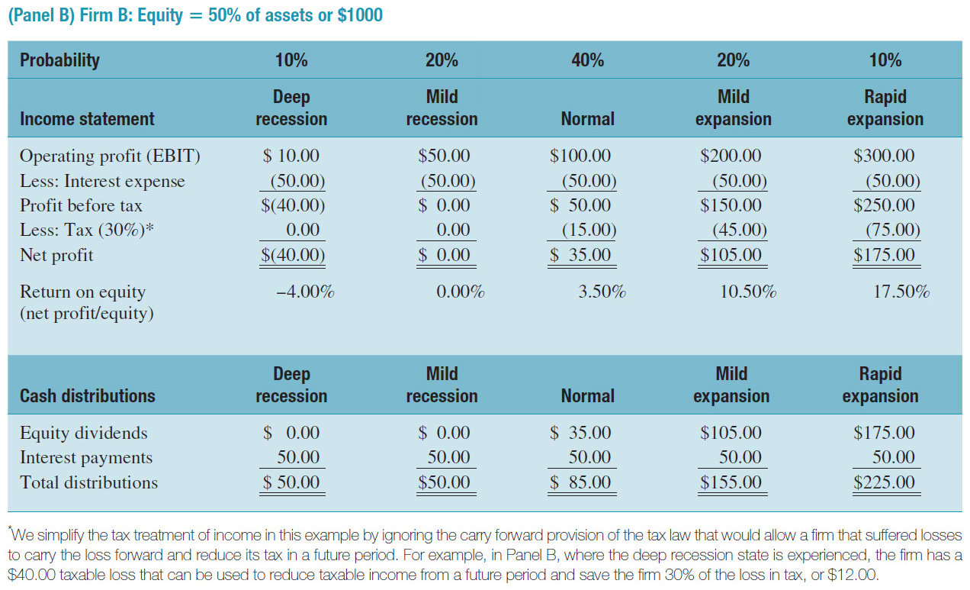
Leverage and the probability of default (cont.)

Slide 94
The trade-off theory and the optimal capital structure
Thus two factors can have material impact on the role of capital structure in determining firm value. Firms must trade off the pluses and minuses of both these factors:
  Interest expense is tax deductible.
  Debt makes it more likely that firms will experience financial-distress costs.

Slide 95
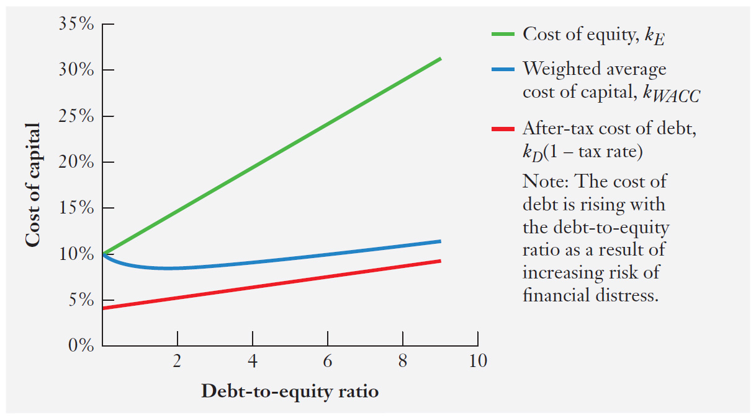
The cost of capital and the trade-off theory

Slide 96
Capital structure decisions and agency costs
Debt financing can help reduce agency costs, which are incurred when managers owning only a small fraction of the firm’s shares make decisions that are not in the best interests of shareholders.
For example, debt financing by increasing fixed dollar obligations will reduce the firm's discretionary control over cash and thus reduce wasteful spending.

Slide 97
Managerial implications
Higher levels of debt can benefit the firm due to tax savings and the potential to reduce agency costs.
Higher levels of debt increase the probability of financial distress costs and offset the tax and agency cost benefits of debt.

Slide 98
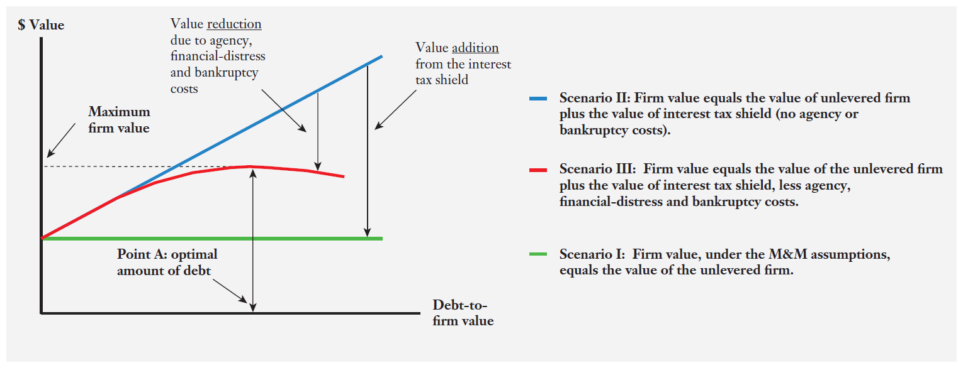
Capital structure and firm value with tax, agency costs and financial-distress costs

Slide 99
Why do capital structures differ across industries?
Firms in some industries (such as utilities) tend to generate relatively more taxable income and can benefit more from tax savings on debt.
Financial distress can be fatal for some companies (like computer and software firms), as consumers will be very reluctant to buy the product if there is a possibility of bankruptcy. Thus such firms will tend to have lower levels of debt.

Slide 100
Survey evidence: Factors that influence CFO debt policy
Following Figure reports the survey results of 392 CFOs who were asked about the potential determinants of capital structure choices on a scale of 0 to 4 (0 = not important, 4 = very important).

Slide 101
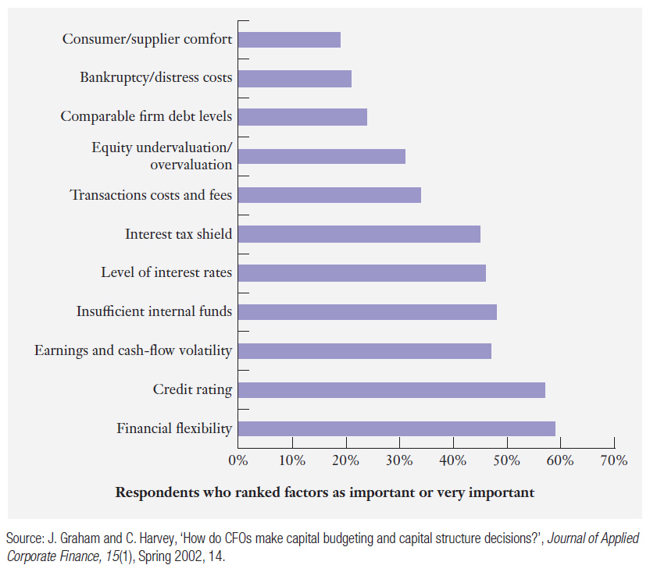
CFO opinions regarding factors that influence corporate debt use

Slide 102
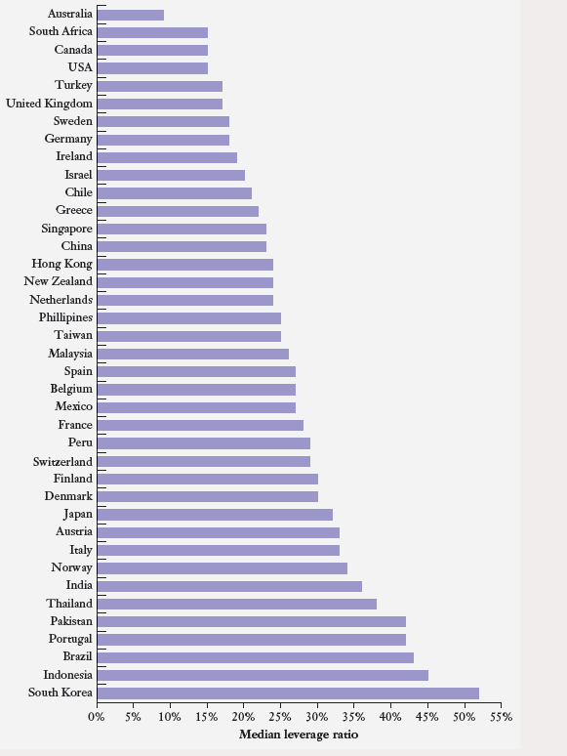
Capital structures around the world
Source: Fan, Joseph P. H., Twite, Garry J. & Titman, Sheridan, An International Comparison of Capital Structure and Debt Maturity Choices (October 4, 2011). AFA 2005 Philadelphia Meetings.

